Slide 1
Weekly meeting
4 25 2024
Ty Bottorff

Slide 2
Outline
P576-1 PCAs, VPs, comparing to P452

Slide 3
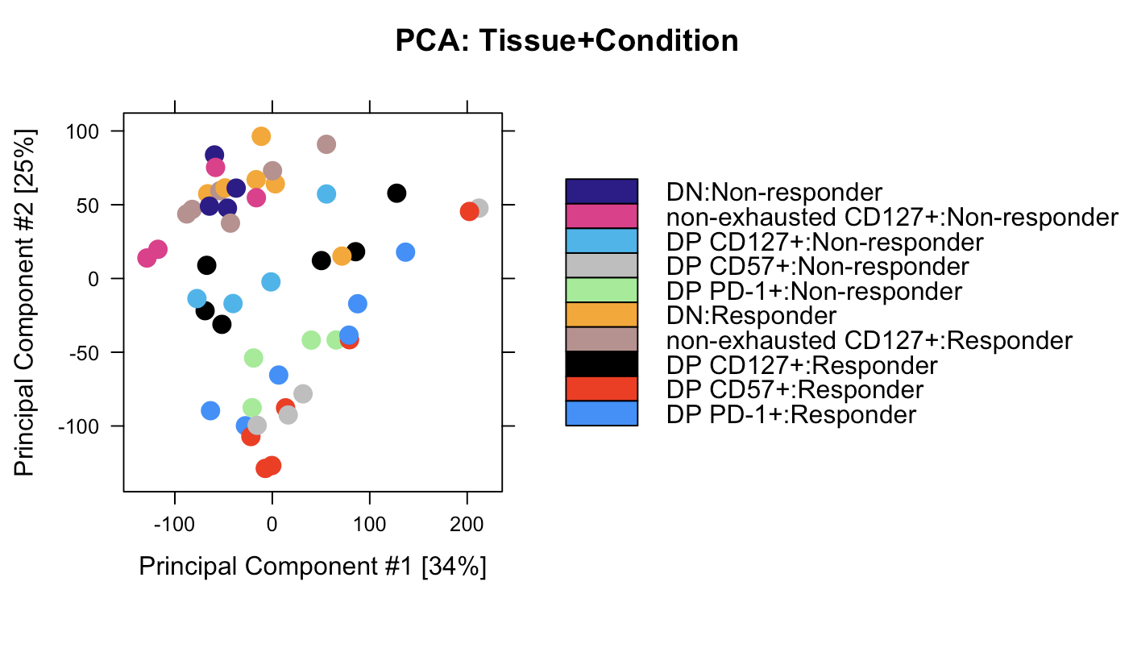
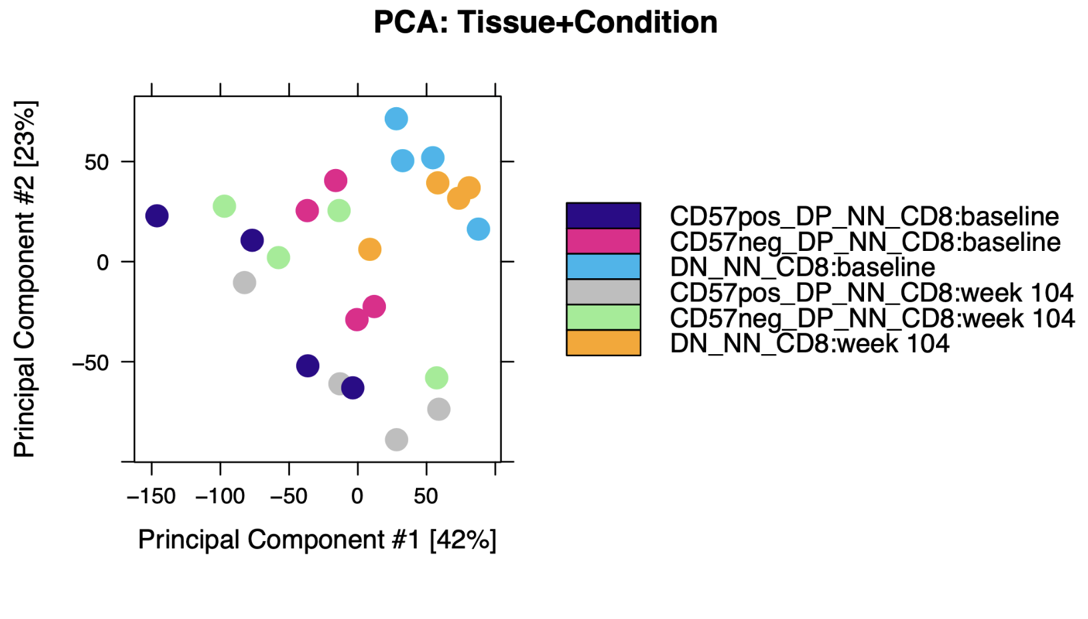
Relatively high variability between replicates
P576
P452 (Erin’s)

Slide 4
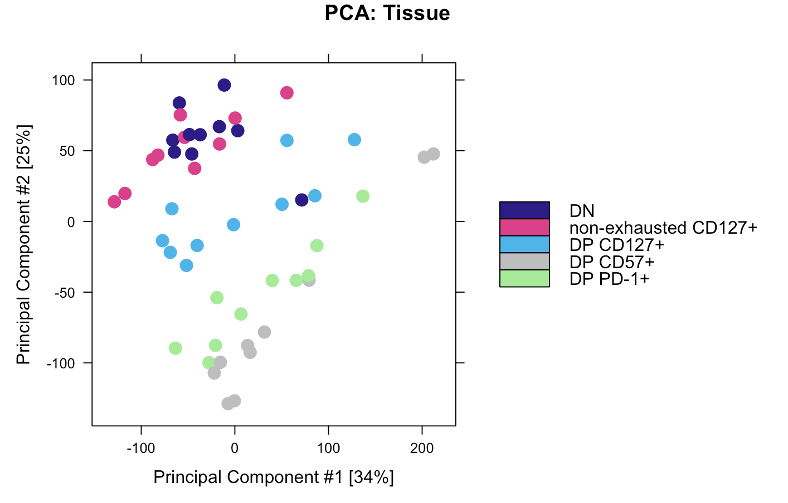
DP CD127⁺ appears to be distinct, non-intermediate cell state from DP PD-1⁺ and DP CD57⁺

Slide 5
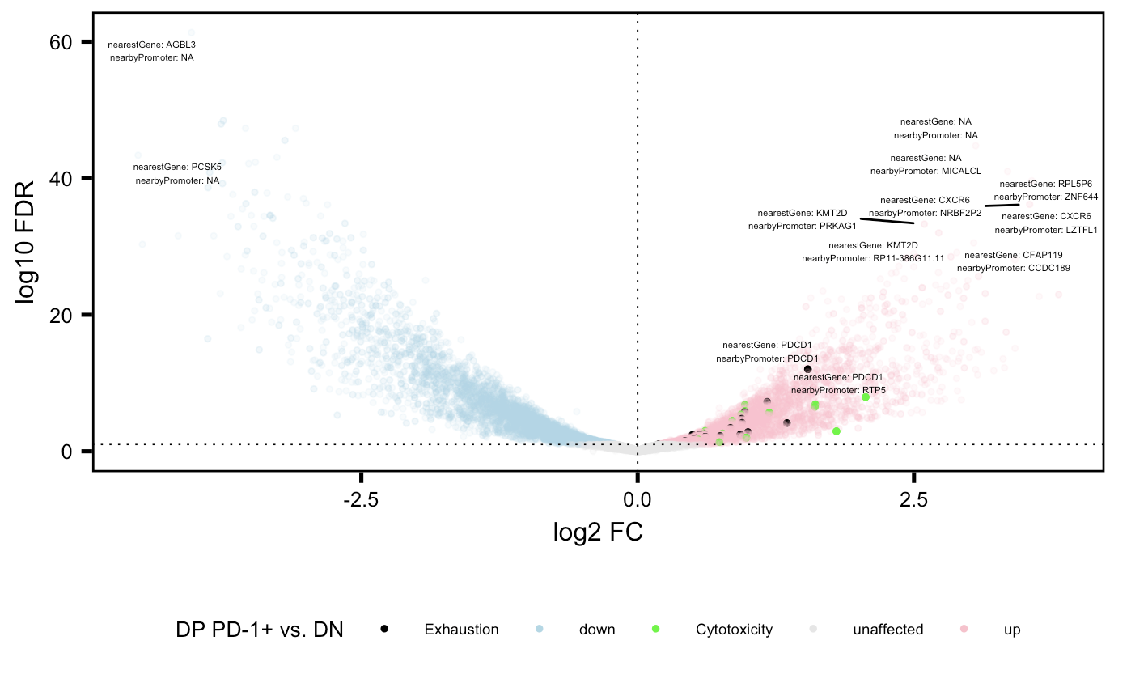
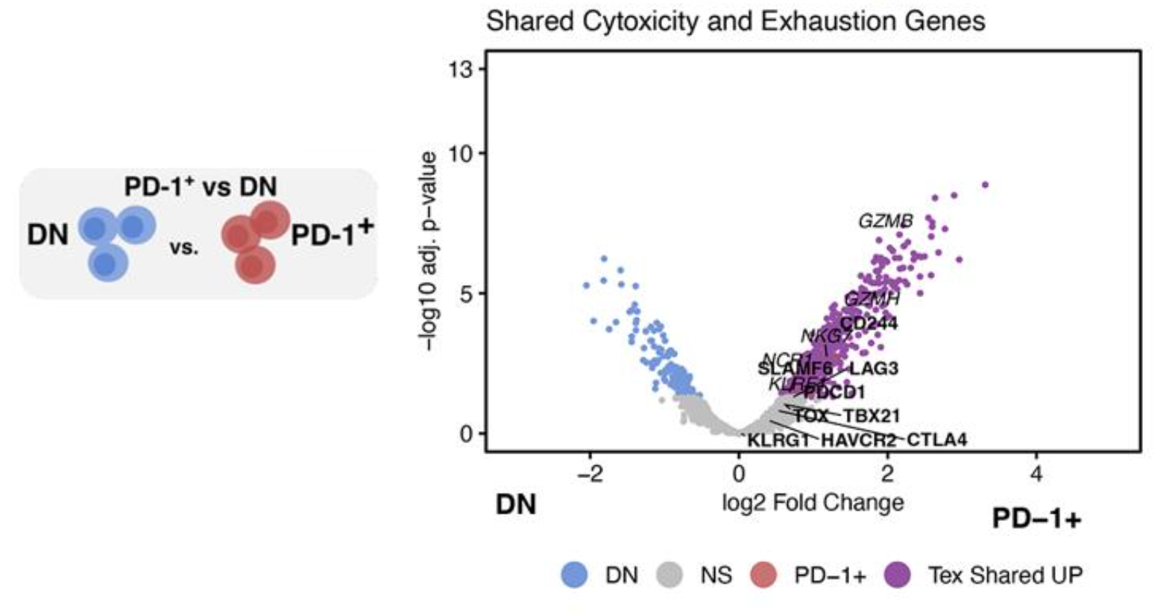
Cytotoxicity and exhaustion genes more accessible in DP PD-1⁺ relative to DN in both projects
P576
P452 (Erin’s)

Slide 6
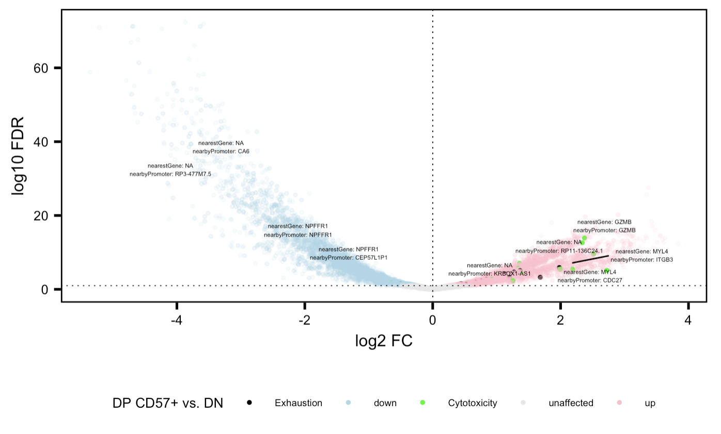
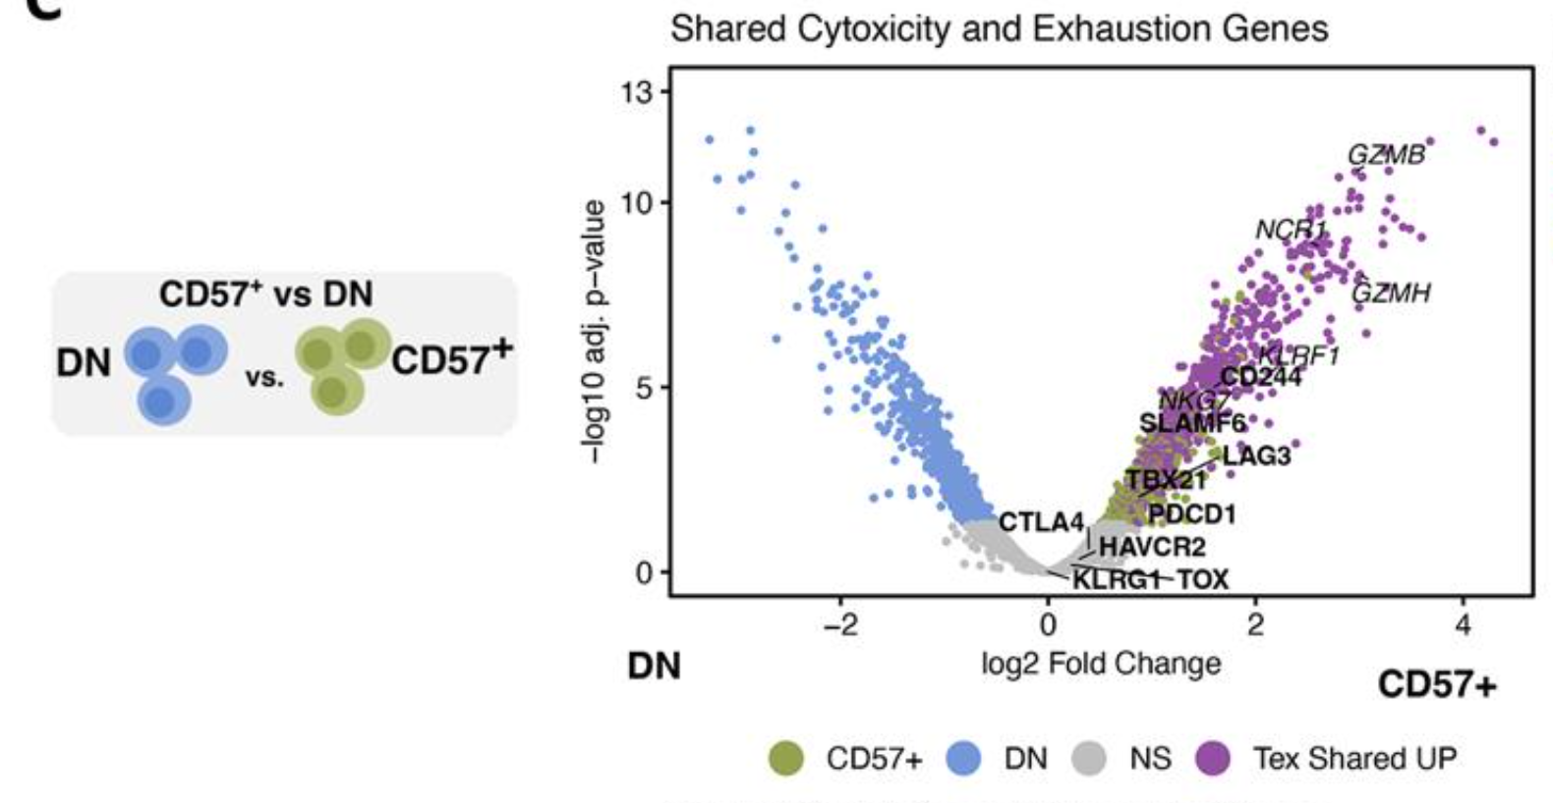
Cytotoxicity and exhaustion genes more accessible in DP CD57⁺ relative to DN in both projects
P576
P452 (Erin’s)

Slide 7
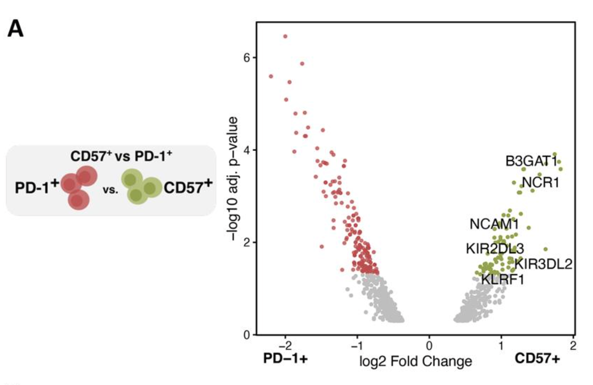
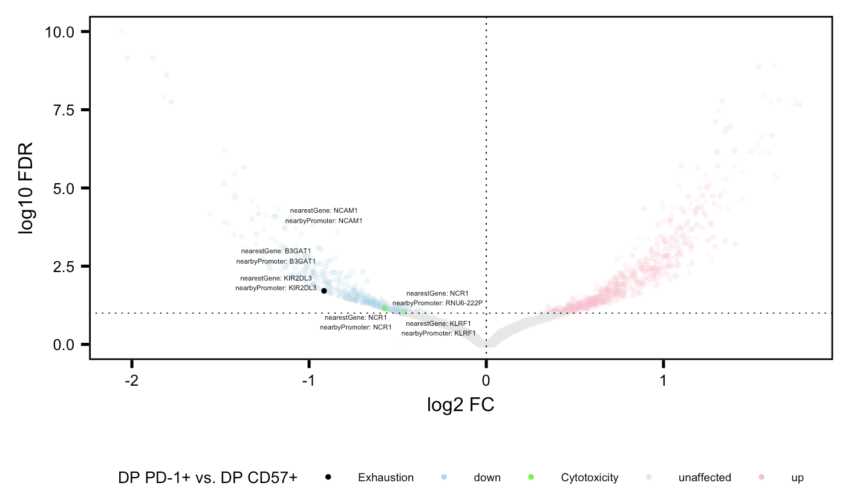
Same genes more accessible in CD57⁺ relative to PD-1⁺ in both projects
P576
P452 (Erin’s)

Slide 8
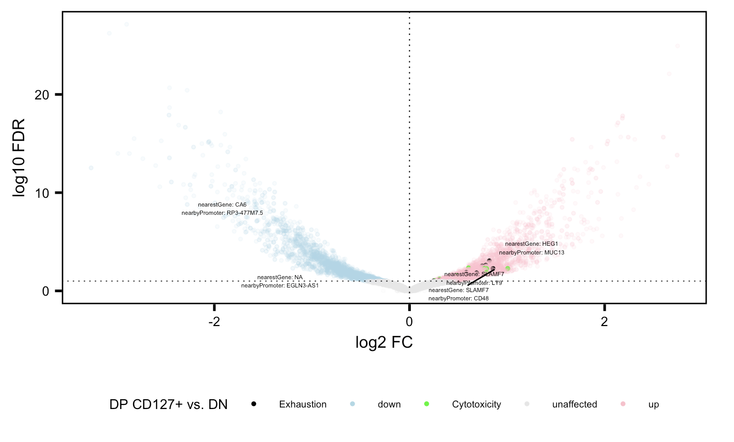
Cytotoxicity and exhaustion genes more accessible in DP CD127⁺ relative to DN

Slide 9
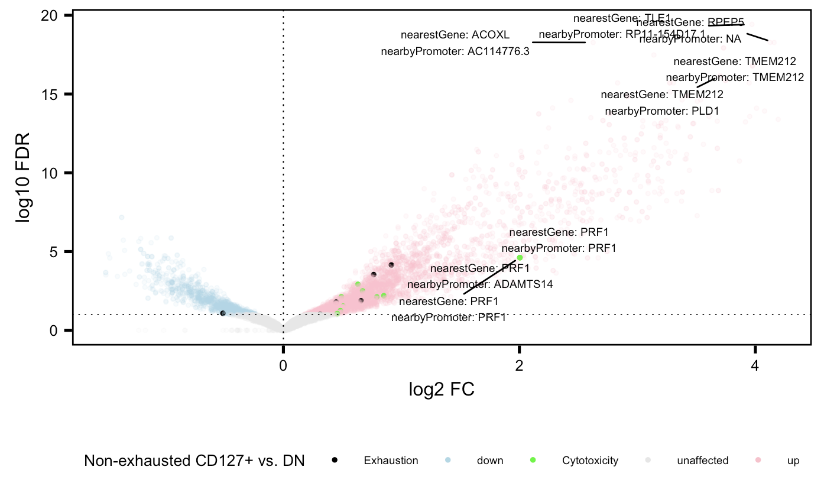
Cytotoxicity (and to a lesser extent exhaustion) genes more accessible in non-exhausted CD127⁺ relative to DN

Slide 10
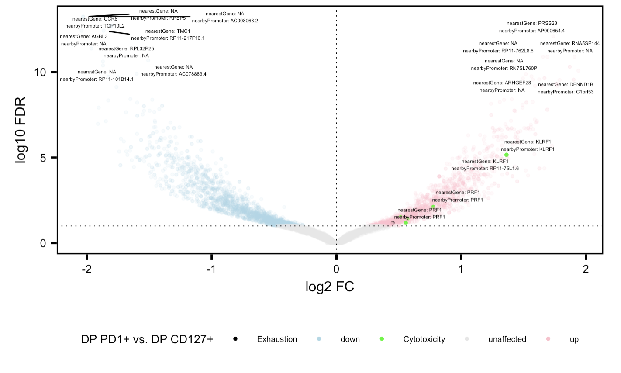
Cytotoxicity genes more accessible in DP PD-1⁺ relative to DP CD127⁺

Slide 11
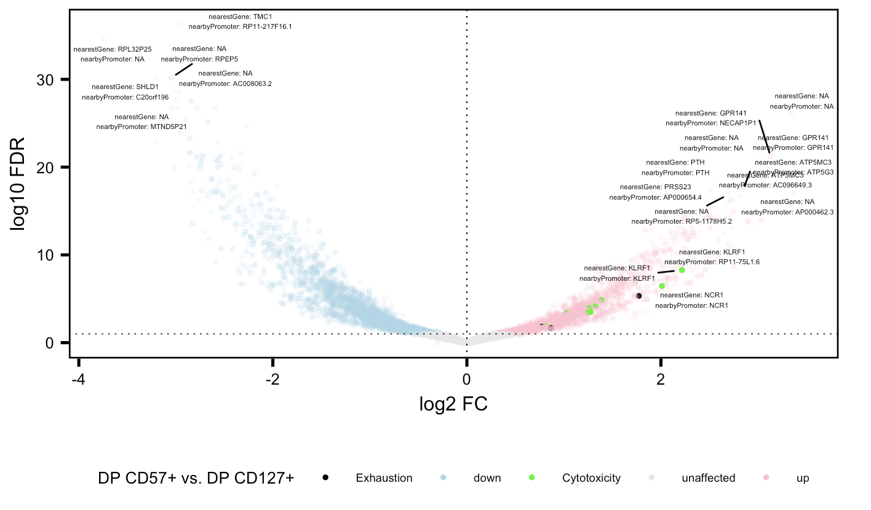
Cytotoxicity and exhaustion genes more accessible in DP CD57⁺ relative to DP CD127⁺

Slide 12
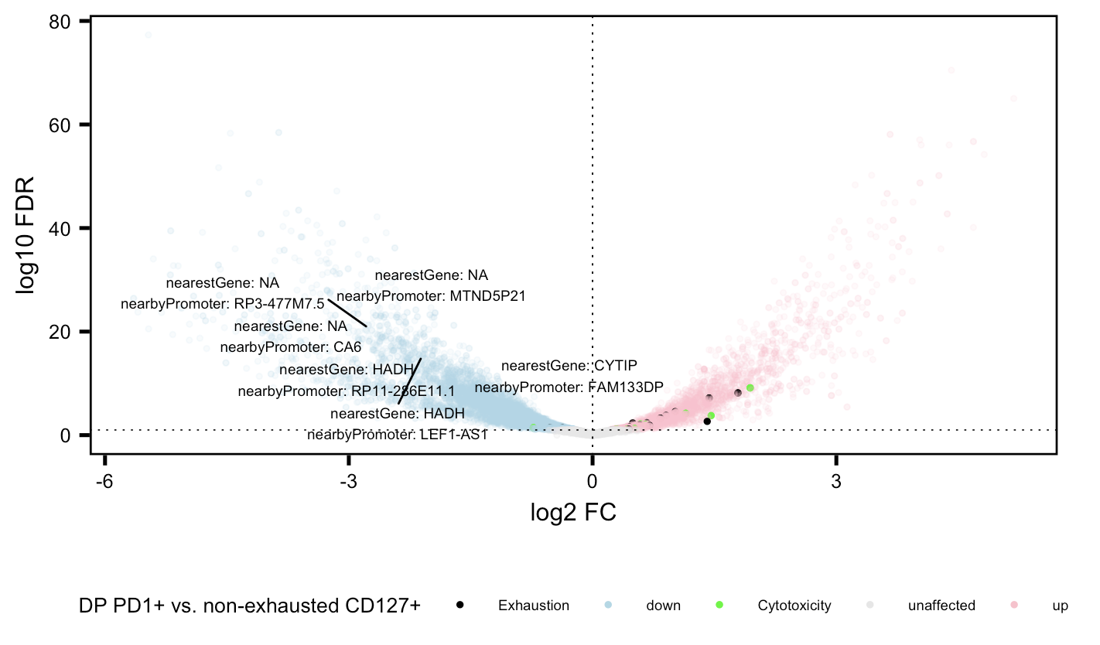
Cytotoxicity and exhaustion genes more accessible in DP PD-1⁺ relative to non-exhausted CD127⁺

Slide 13
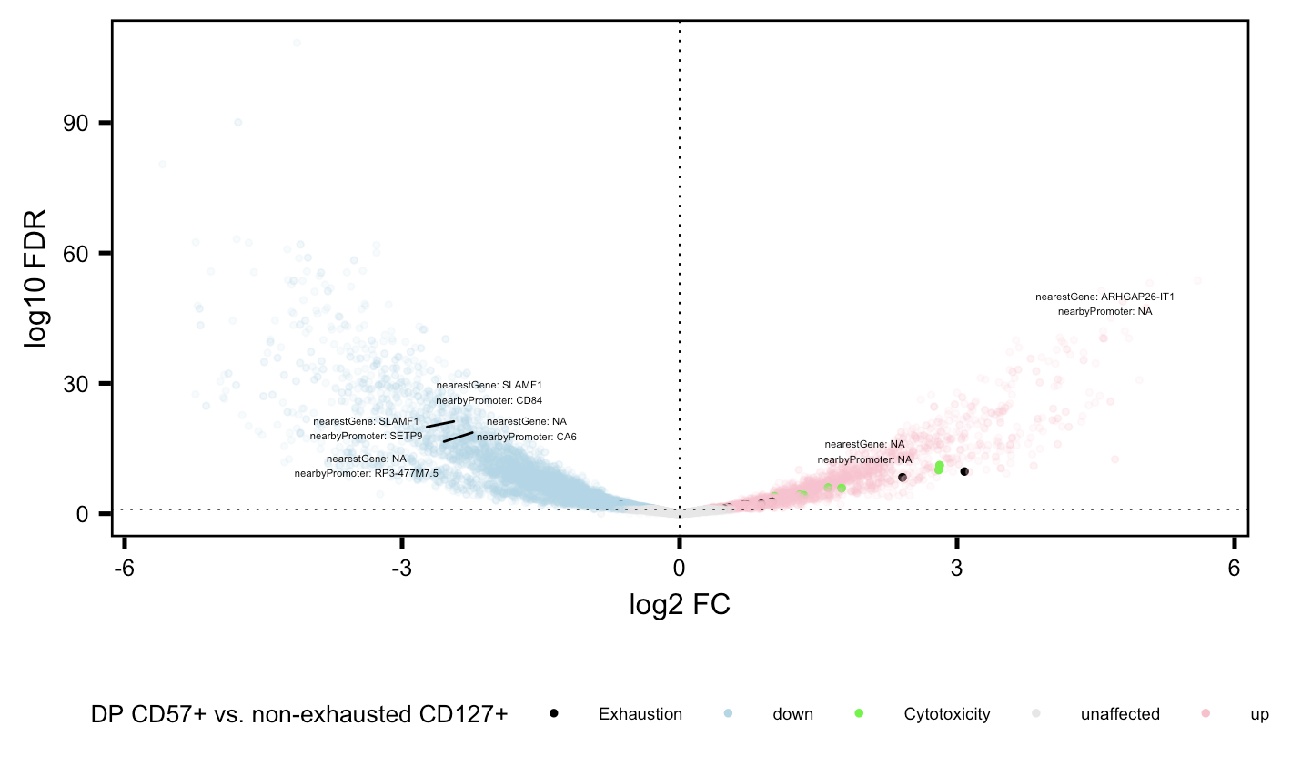
Cytotoxicity and exhaustion genes more accessible in DP CD57⁺ relative to non-exhausted CD127⁺

Slide 14
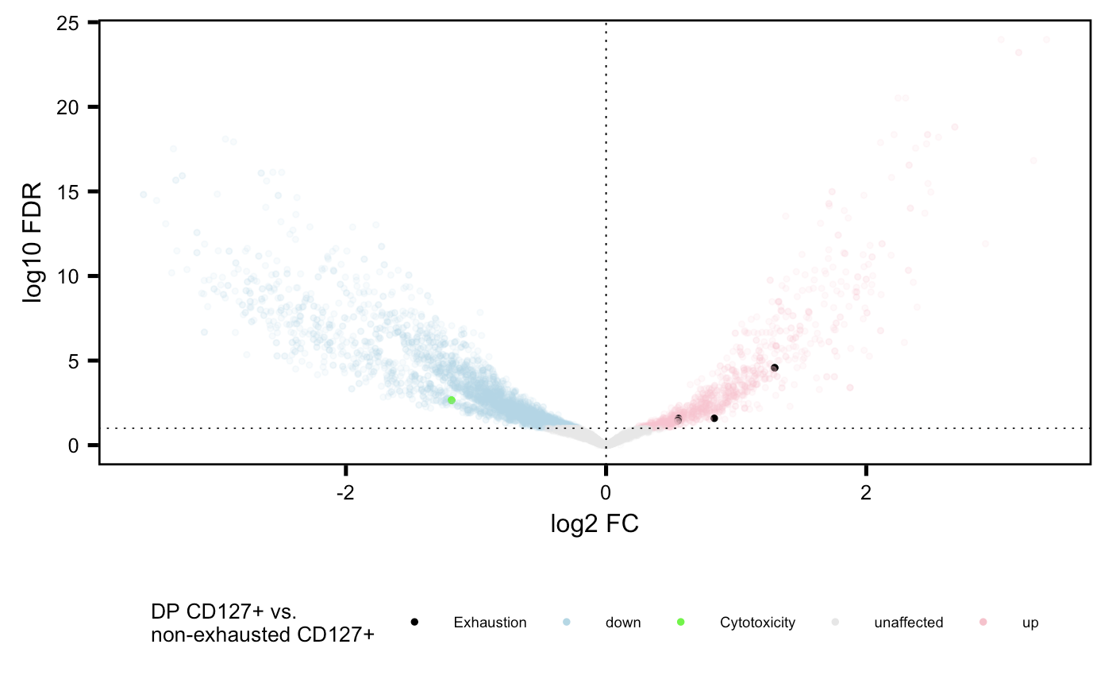
Exhaustion genes more accessible in DP CD127⁺ relative to non-exhausted CD127⁺

Slide 15
Conclusions
Similar cell sort VP comparisons look similar b/w P576 and P452
New cell sort comparisons
Cytotoxicity and exhaustion genes more accessible in…
DP CD127⁺ relative to DN
DP CD57⁺ relative to DP CD127⁺
DP PD-1⁺ and DP CD57⁺ relative to non-exhausted CD127⁺
Cytotoxicity (~exhaustion) genes more accessible in non-exhausted CD127⁺ relative to DN
Cytotoxicity genes more accessible in DP PD-1⁺ relative to DP CD127⁺
Exhaustion genes more accessible in DP CD127⁺ relative to non-exhausted CD127⁺
DP CD127⁺ appears to be distinct, non-intermediate cell state from DP PD-1⁺ and DP CD57⁺

Slide 16
Next steps
Similar to Erin’s lineage sharing based on ATACseq analysis, alternative way to probe lineage sharing b/w DP CD127⁺, DP CD57⁺, and DP PD-1⁺
Compare changes between these 3 sorts and DN
Are many DARs shared (in same direction) between the 3 cell sorts and DN? i.e. make a new T_{ex} shared up and color across the 3 cell sorts vs. DN
GSEA on up/down genes for each VP
More analysis on data similarity between same cell sorts in P576/P452?

Slide 17
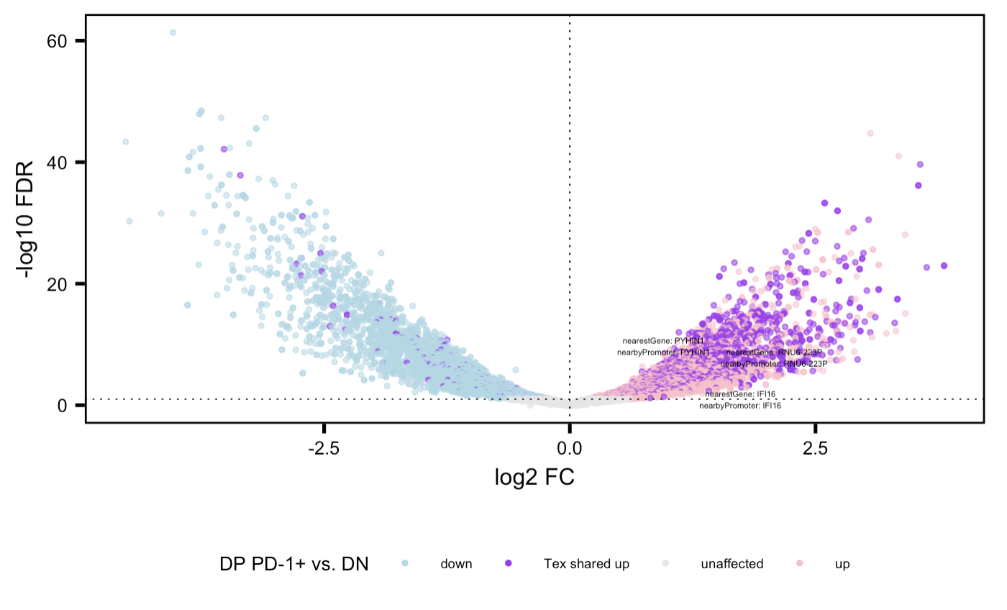
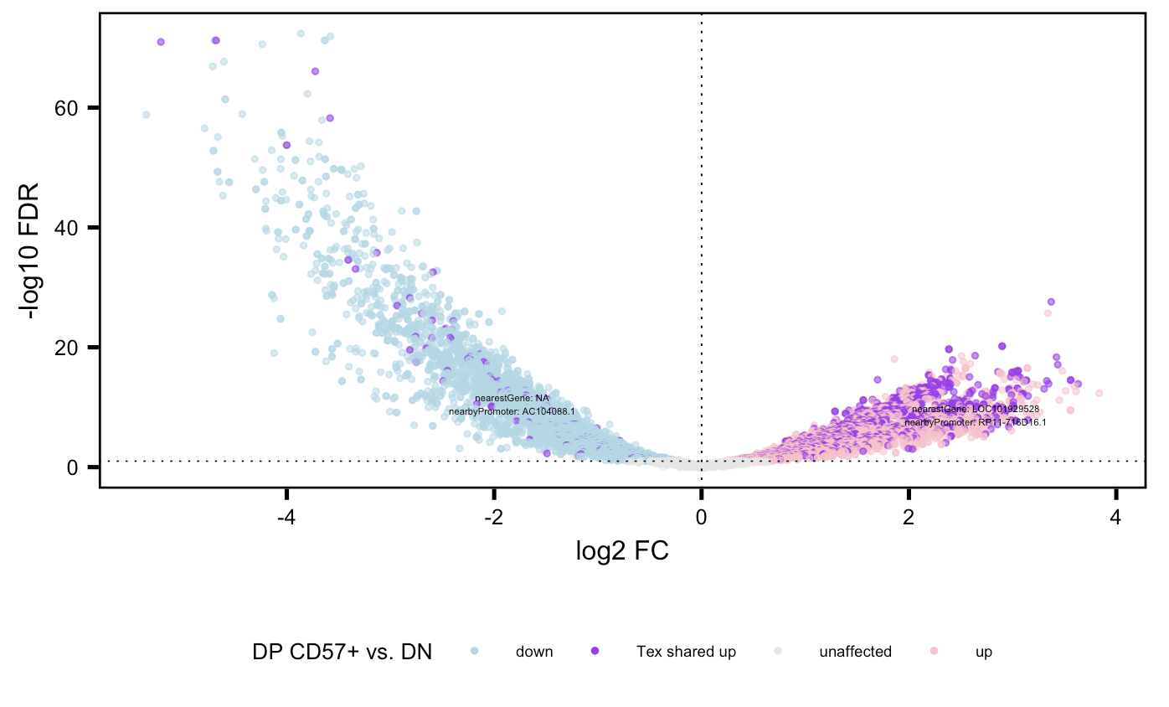
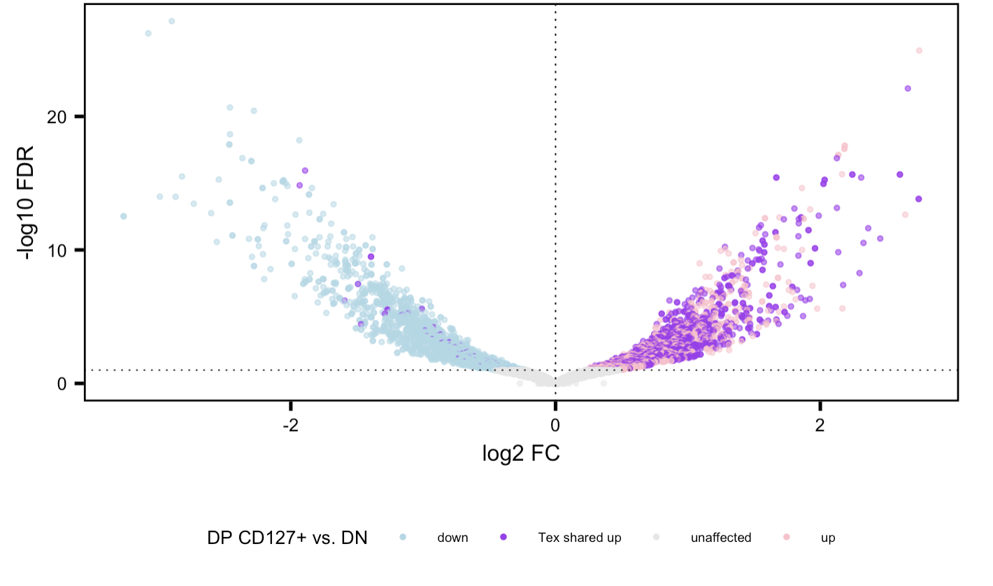
Preliminary work on next steps: does seem to be high degree of sharing of up genes b/w 3 cell sorts, but need to deal with same gene having multiple associated peaks (sometimes with both +/- FC?)
Methods:
1. look at all positive log2 FCs between each sort and DN, also filter for FDR < 0.05
2. then look for genes appearing in all 3 lists
3. color purple for such genes

